Slide 1


TWEFS ENTERPRISE
Employee data analysis
Presented by: Chime Stephanie, Odewusi Kolawole, Faith Umoren, Tony Gaga and Akinpelu Elizabeth
Strategic Workforce Insight and Recommendations

Slide 2
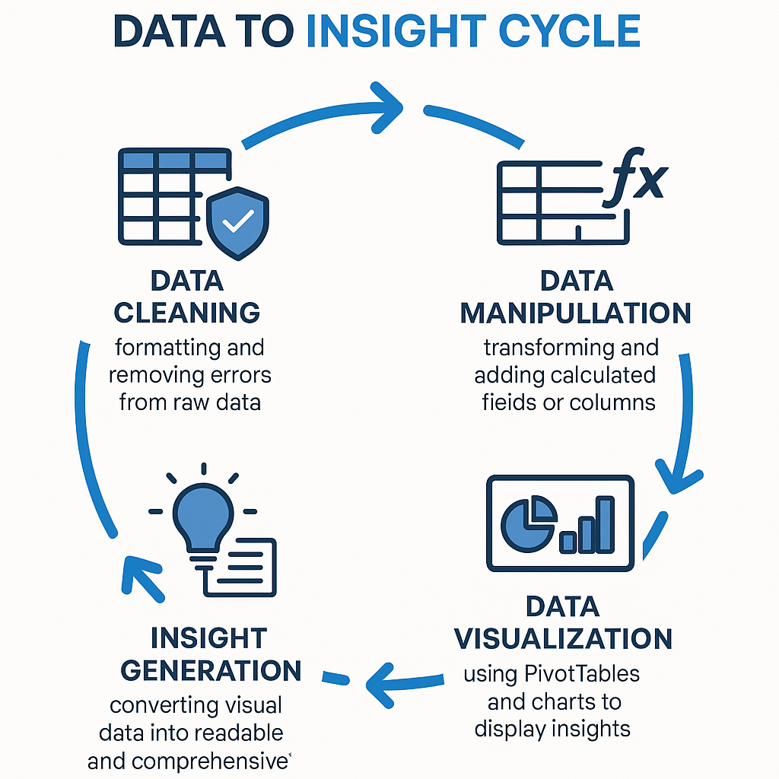

Slide 3

Introduction
This presentation gives a detailed analysis of employee related metrics across departments. Using data visualization, we explored salary distribution, project completion rates, performance scores, and satisfaction levels. With this we uncovered actionable insights that can guide strategic decisions in workforce management, resource allocation, and performance optimization.
By identifying departmental strengths and gaps, this report serves as a foundation for enhancing operational efficiency and driving employee engagement.

Slide 4

Objectives
Understand employee distribution across departments
Analyze salary, performance, and satisfaction by department
Identify which teams complete the most projects
Explore the link between tenure , performance and departments
Understanding if age is a factor for efficiency and experience
Spot areas needing improvement in workforce efficiency
Provision of recommendation and actionable steps that help improve
employment engagement and performance

Slide 5
Core Insights
1. Departmental Performance & Contribution
HR leads in both project completion (327 total) and average performance score (3.24) — indicating a highly efficient and effective department.
Marketing accounts for the largest workforce (27%) and the highest salary cost ($386.2K), contributing the second-highest in projects (293).
IT has the lowest performance score (2.45) despite a relatively high salary allocation ($268.9K) and the second-highest work hours (1,244 hrs), showing signs of overburden without adequate output.
Sales is persistently at the bottom across metrics: lowest employees (15%), projects completed (228), salary ($202.2K), and work hours (890 hrs).

Slide 6
Core Insights
Salary Insights by Department
HR offers the highest average salary ($10,332), which aligns with its top performance and satisfaction scores this is indicating strong ROI on compensation investment.
Marketing pays the second-highest average salary ($9,655) but returns the lowest satisfaction (0.71) and only mid-tier performance (3.10) which could result to questions about compensation effectiveness.
Sales and IT receive lower average salaries ($8,793 and $8,674 respectively) yet still show underwhelming output and satisfaction, implying issues deeper than compensation — potentially in team structure, culture, or leadership.
Finance displays a reasonable alignment between salary ($9,966), performance (3.11), and workload, suggesting a stable department.

Slide 7
Core Insights
2. Age Group Trends
50-60 age group has the highest productivity: 481 projects, average performance 3.16, and satisfaction 0.75 — making them the most effective age segment.
40-49 age group shows lowest performance (2.60) and satisfaction (0.71), suggesting potential disengagement or misalignment.

Slide 8
Core Insights
3. Tenure-Based Performance
6–7 years tenure shows the highest performance (3.10), proving that longer employee retention correlates with better output.
2–3 years tenure remains lowest in performance (2.80) across all groups, suggesting potential onboarding or training gap.
4. Employee Satisfaction
HR leads in satisfaction (0.75), reinforcing the importance of work environment in driving productivity.
Marketing, despite its size and resource allocation, has lowest satisfaction (0.71) — a major red flag in workforce ROI.

Slide 9
Key Problems Identified
Underperformance of High-Spending Departments
  Marketing receives the highest salary allocation and second highest average salary, but underdelivers on employee satisfaction and performance.
  IT shows low performance despite high investments and workload.
  These inefficiencies reflect misaligned compensation and ineffective workforce management.
Sales Department Performance Crisis
  Consistently the lowest across all major KPIs — needs urgent intervention in motivation, training, or structure.
Youth and New Tenure Performance Gap
  Newer employees (2–3 years) and younger staff (20–29) underperform, suggesting gaps in onboarding, mentorship, or clarity in role expectations.
Workload Imbalance
  IT carry significantly heavier workloads with limited performance returns, which may contribute to burnout and lower satisfaction.
  Salary imbalances, particularly in Marketing and HR, require realignment to ensure ROI matches investment.

Slide 10
Strategic Recommendations
Short-Term Fixes
Employee Engagement Surveys in Marketing and IT to uncover causes of dissatisfaction and stress.
Performance Audits in Sales to identify skill gaps, operational bottlenecks, and leadership weaknesses.
Onboarding Overhaul for employees under 3 years tenure — implement mentorship, performance incentives, and upskilling.
Redistribute Projects to ease workload from Marketing and IT; HR can absorb more given its consistent high performance.
Salary Structure Review in Marketing in order to align pay with actual productivity or implement KPIs to justify current salary levels.

Slide 11
Strategic Recommendations
Long-Term Strategy
Retention Plans for 6–7 Year Tenure Group: Create leadership pipelines and compensation incentives to retain top performers.
Age-Specific Coaching: Boost productivity in 40–49 age group through targeted engagement and reskilling.
Departmental Rebalancing: Consider shifting resources from underperforming departments to those yielding better ROI .
HR as a best practice Model: Replicate HR’s best practices across departments—especially in training, satisfaction, and performance management.

Slide 12
Conclusion
The TWEFS workforce landscape shows critical misalignments between compensation, workload, and performance, especially in Marketing, IT, and Sales. In Addition, stands out as the mode ldepartment with high satisfaction, maximum output, and strong leadership. Age and tenure factors play a critical role in driving performance — emphasizing the need to focus on retention, structured onboarding, engagement programs, and strategic salary reviews.
With targeted improvements in employee engagement, recalibrating investments, training, and workload distribution, TWEFS can drive a more balanced, high-performing, and satisfied workforce, maximizing both ROI and human capital value.

